Slide 1
Discord’s Dynamic Content in Slack’s Sleek UI
A design and frontend implementation challenge
Objective: Merge Discord’s homepage features with Slack’s UI aesthetics.

Slide 2
Design Choices
Slack’s Layout & Colors:
Primary : #48224c
Secondary : #59355d, #fff
Tertiary : #765578
Typography:
sans-serif fonts (Inter, Arial)
UI Components Inspired by Discord:
Sidebar: Navigation & Direct Messages
Navbar: Search & Navigation
Hero Section: shop and products
Effects & Transitions:
Hover effects for interactivity
Smooth CSS Transition
Responsive and adaptive layout

Slide 3
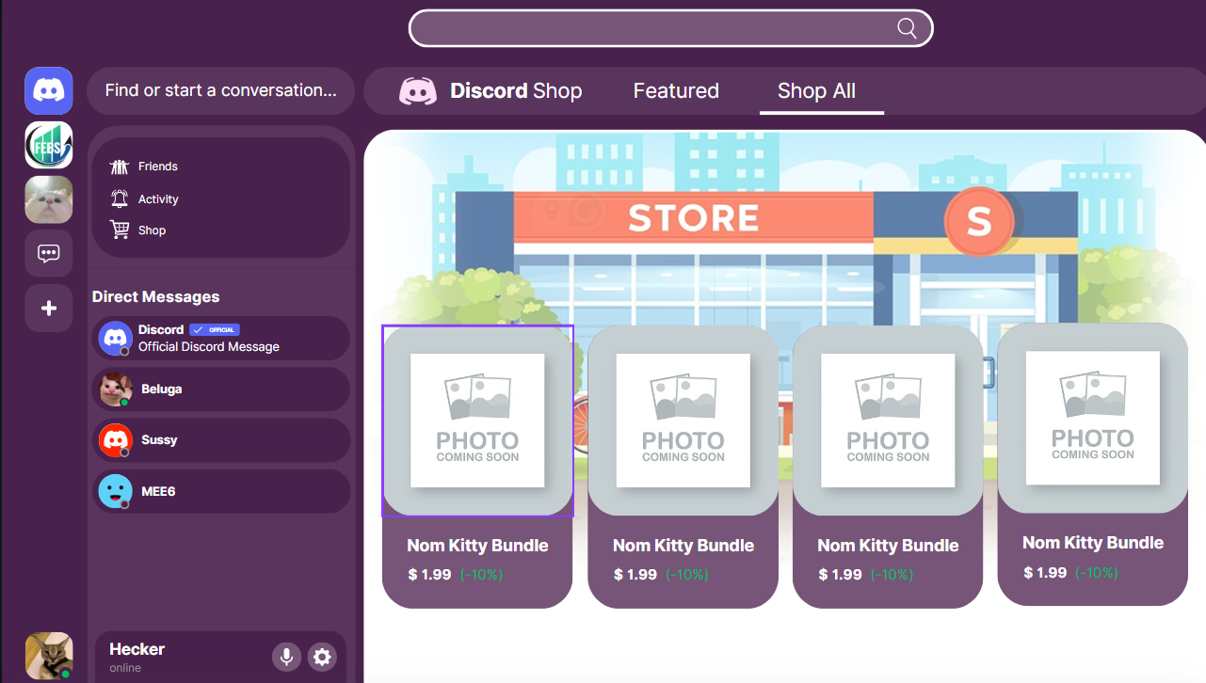
DESIGN IMAGE MADE IN CANVA

Slide 4
Slide 4: Thought Process & Challenges
Design Phase:
Tools: Canva
Development Phase :
HTML & CSS only (No JavaScript)
Challenges :
Implementing complex layouts with pure css.
Making it responsive across devices

